Slide 1
Intro to RPi (Part 2)
By SUTD IEEE

Slide 2
Agenda
Using the RPi through the Terminal
Using the RPi like an Arduino
GP I/O Pins with Python
RPi Serial Communication
Talk to an Arduino using an RPi

Slide 3
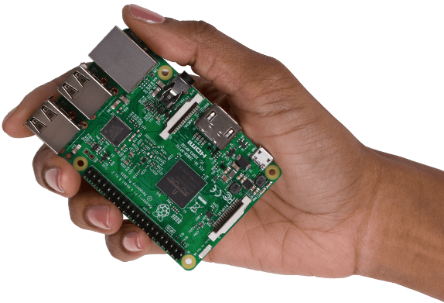
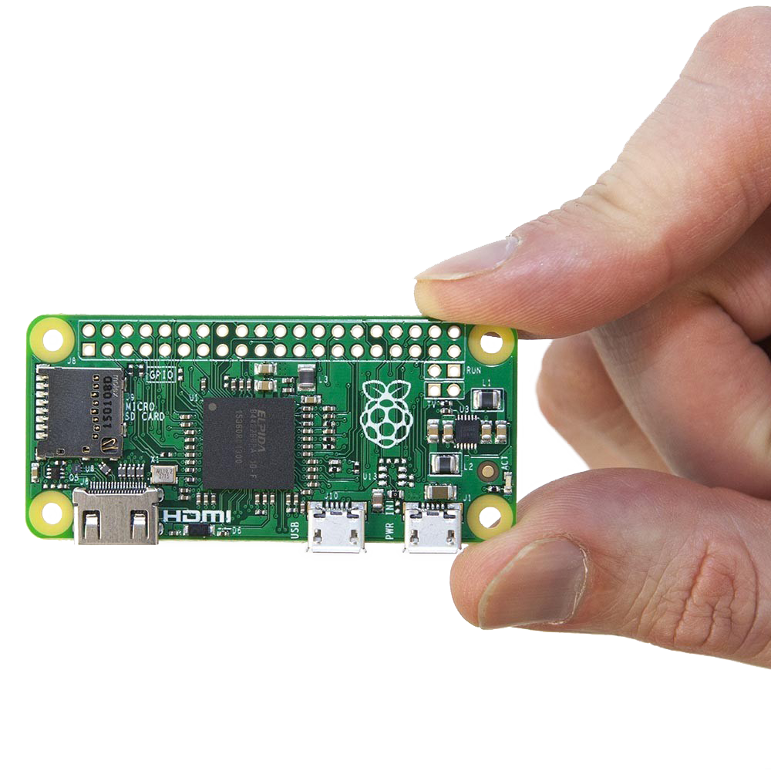
What’s an RPi?!
Single Board Computer
Runs Linux (Most of the time)
Small
Access to GP I/O Pins (Input and Output)
Like an Arduino

Slide 4
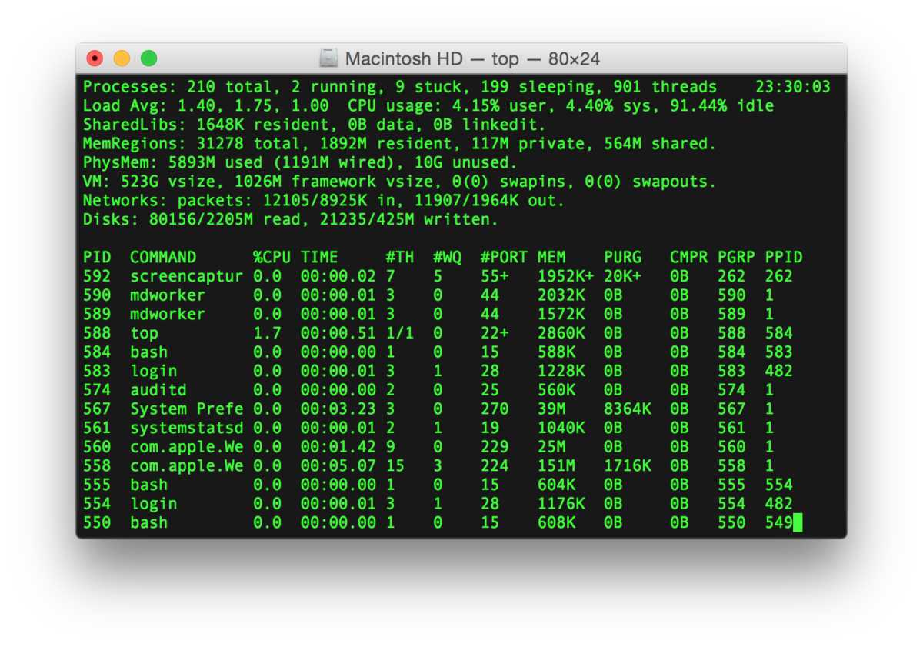
Linux Commands & Tools
cd
ls
touch
rm
mkdir
rmdir
nano
mv
cp
find
cat
Ifconfig

Slide 5
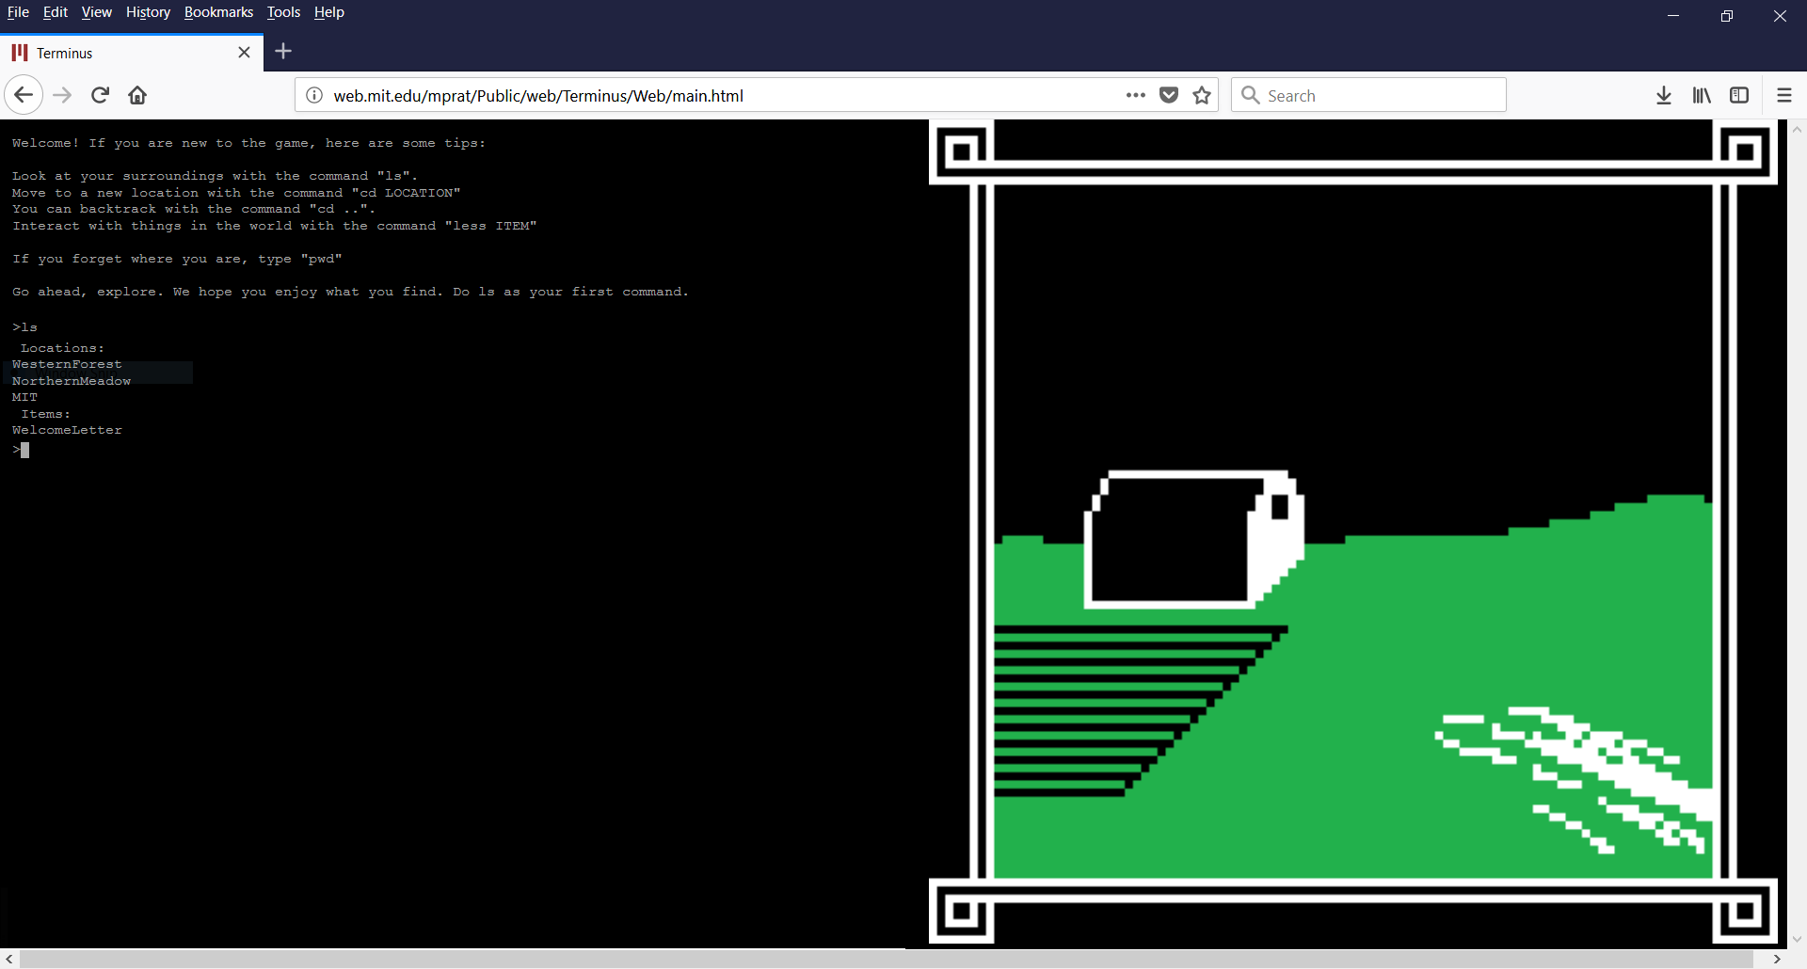
Linux Commands & Tools
http://web.mit.edu/mprat/Public/web/Terminus/Web/main.html

Slide 6
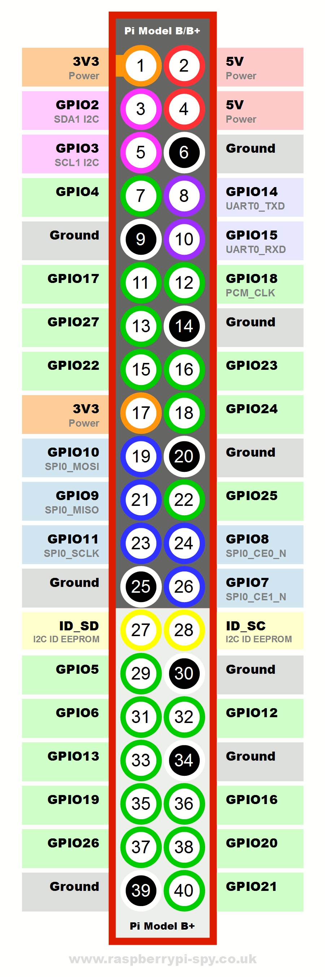
Now for the Electronics Stuff
Program the RPi’s GP I/O Pins
General Purpose Input/ Output
https://pinout.xyz/#
Use it like an Arduino
Can be done using Python, C, C++, Bash, etc.

Slide 7
GP I/O with Python
Install RPI.GPIO (In Terminal)
sudo pip3 install rpi.gpio
In Python File
import RPi.GPIO as GPIO

Slide 8
GP I/O with Python
GPIO.setmode(MODE) => MODE is GPIO.BOARD or GPIO.BCM
GPIO.setup(channel, GPIO.HIGH) => channel can be a list of channels
GPIO.setup(channel, GPIO.HIGH, initial=GPIO.HIGH)
GPIO.input(channel)
GPIO.output(channel) => channel can be a list of channels
GPIO.PWM(channel,frequency)
GPIO.cleanup()

Slide 9


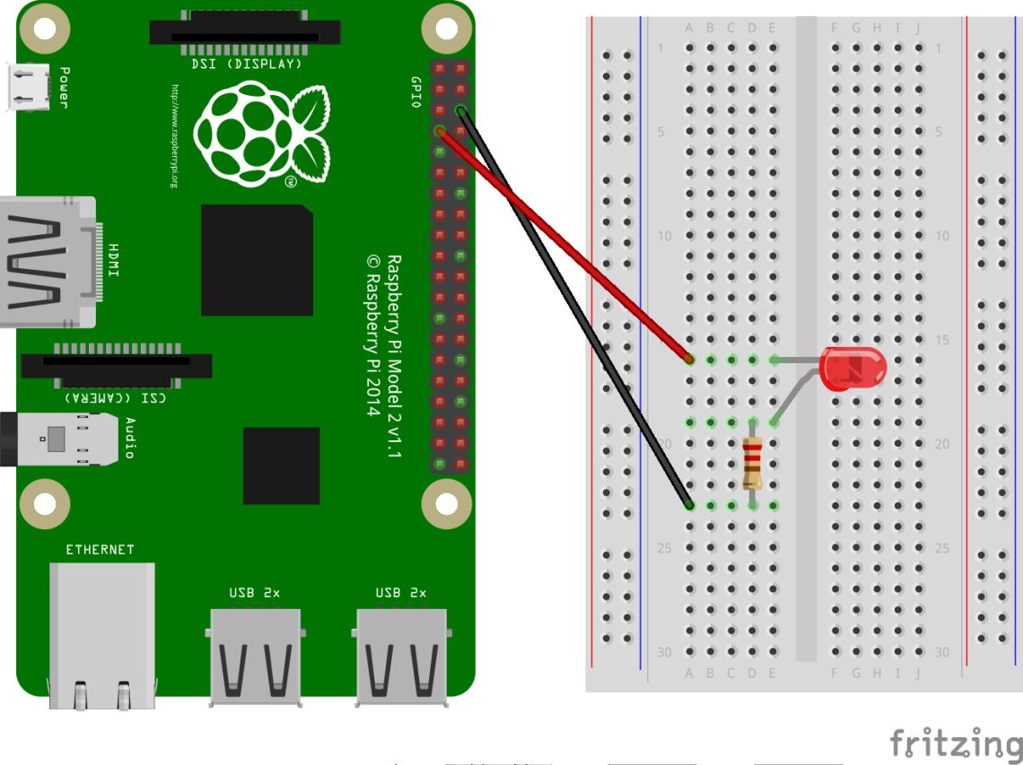
Activity #1: Blinking LED
Connect +ve lead of LED (Longer leg) to BCM26
Refer to https://pinout.xyz/# !
Connect a resistor from the –ve lead of the LED to an empty space
Connect the resistor to a GND pin
Refer to https://pinout.xyz/# !

Slide 10
Activity #1: Blinking LED
import RPi.GPIO as GPIO
from time import sleep
import sys
GPIO.setmode(GPIO.BCM)
GPIO.setup(26,GPIO.OUT)
GPIO.output(26,GPIO.HIGH)
sleep(1) // Sleep for 1s

Slide 11
Activity #1: Blinking LED
Try:
while True:
# Do Something
finally:
GPIO.cleanup()
sys.exit()

Slide 12
Activity #2: Fading LED
Connect +ve lead of LED (Longer leg) to BCM26
Refer to https://pinout.xyz/# !
Connect a resistor from the –ve lead of the LED to an empty space
Connect the resistor to a GND pin
Refer to https://pinout.xyz/# !

Slide 13
Activity #2: Fading LED
pwm = GPIO.PWM(26,1000)
pwm.start(0)
pwm.ChangeDutyCycle(x) // 0 ≤ x ≤ 100
for i in range(100):
pwm.stop()

Slide 14
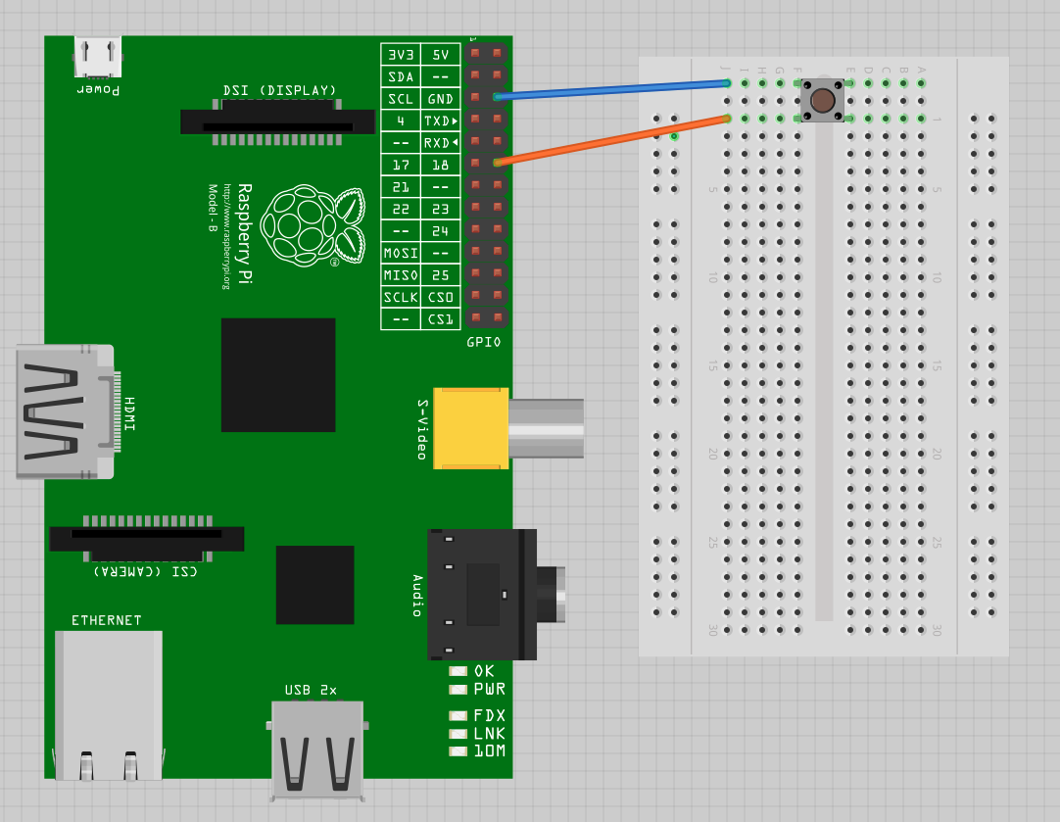
Activity #3: Push Button
Connect one end of the button to BCM26
Connect the other end on the same side to GND

Slide 15
Activity #3: Push Button
GPIO.setup(26,GPIO.IN,pull_up_down=GPIO.PUD_UP)
GPIO.input(26)

Slide 16
Activity #3: Push Button - Debounce
Oscillation in mechanical switch in button => Multiple button presses
Logic:
Wait for x ms after button pressed and until button is released
Only then register it as 1 button press

Slide 17
Activity #4: TRY It Yourself
Use a push button to toggle an LED on and off!
TRY!

Slide 18
Serial Communication
Send data bit by bit, instead of all at once
Many protocols:
UART / USART
SPI
I2C
…

Slide 19
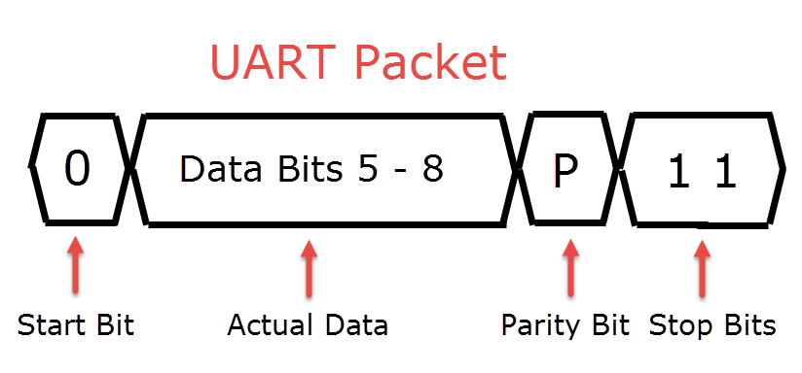
Serial Communication (UART)
Universal Asynchronous Receiver-Transmitter
Star-Bit
Data Bits
Parity Bit (Optional)
Stop Bit/s

Slide 20
Python Serial in RPI (With Arduino)
Why?
Offload processing and simple tasks to Arduino
Add more input/ output pins
Connect to other serial peripherals
How?
Connect a USB cable from the Pi to the Arduino

Slide 21
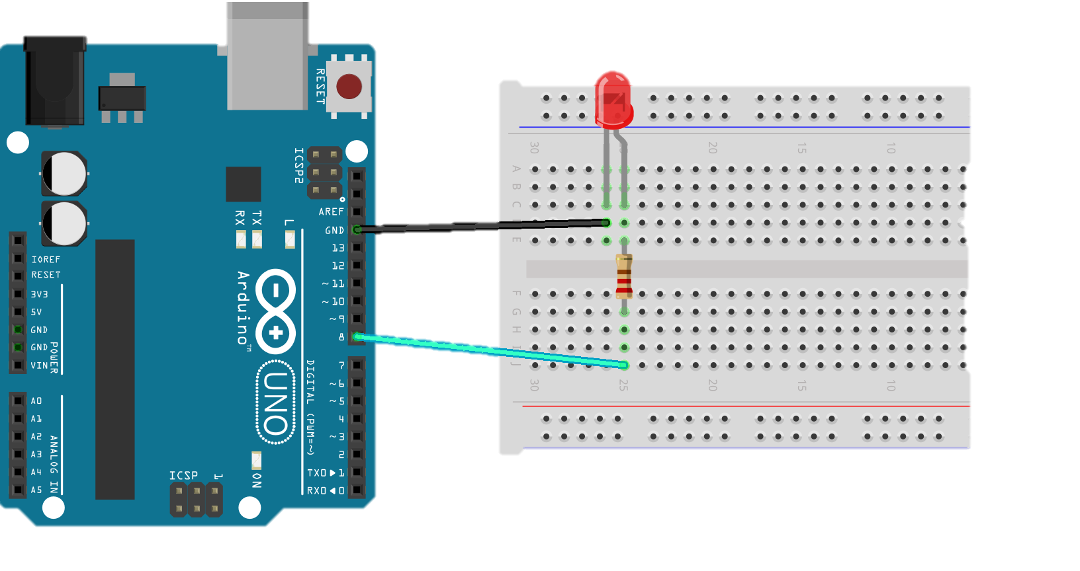
On Arduino
String inString = “”; void serialEvent() { char c = ‘ ’; c = Serial.read(); if (c == ‘\n’) { // Do something inString = “”; } else { inString += c; } }

Slide 22
SPI and I2C
RPi has:
3 SPI Bus’s (Only one accessible via the headers)
2 I2C Bus’s accessible through the headers
I think

Slide 23
The ENd

